Slide 1
FEMINISM
Beauty Health and Fitness

Slide 2
Introduction
Beauty standards are a social construct since they vary from culture to culture. Female beauty has become a controversial issue in the recent age where women are pressured to conform to unrealistic body standards.
For instance, in the US, the beauty ideals for women have changed drastically since the 1970’s from the mature and curvaceous figure to a thin and flat chested appearance.
Women are succumbed to unnecessary pressure to achieve this ideal look by taking up absurd diets, cosmetic surgery and cosmetic products.
Unfortunately, men are not succumbed to the same kind of pressure concerning their physical appearance which is why the issue of beauty standards is a major concern of feminists.

Slide 3
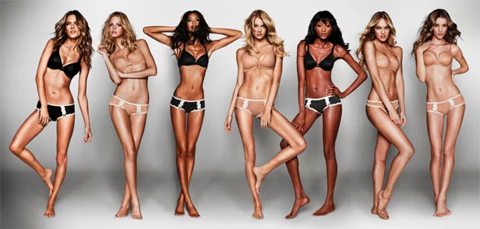
Technology and Advertisements
The media plays a key role in perpetuating these unrealistic standards mostly through advertisements and celebrities who are viewed as role models.
A good example of such advertisements are the Victoria Secret’s supermodels.
Young women have access to social media and such images make them feel insecure about their own bodies.

Slide 4
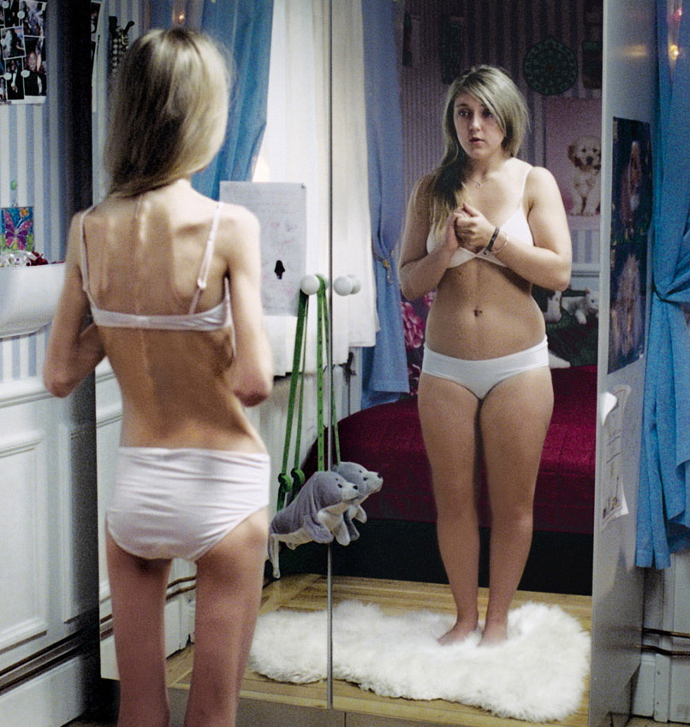
Feminist perspective
American ideal body for a woman – Thin and frail.
American ideal body for a man – Large and muscular.
Just as women were beginning to gain in other areas such as politics education and politics, beauty ideals for them changed to a weak and emaciated figure which is naturally less threatening.
Women therefore have to continuously discipline themselves through diet and exercise and this sometimes affects women negatively as they are constantly insecure about their looks.

Slide 5
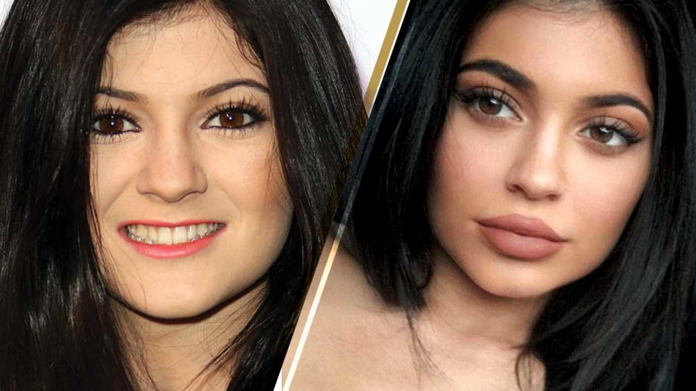
Weight loss and plastic surgery
According to Naomi Wolf, 1990 in her book on the beauty myth, 90% of American women think they are overweigh and half this number is dieting to deal with the issue.
Around $40 billion dollars is spent each year on weight loss products.
A more recent trend on cosmetic surgery to modify one’s features for a desired look has had a large effect on women both young and old. Some huge celebrities such as the Kardashians and Kylie Jenner have had major modifications on their faces and lips creating a huge trend to achieve a certain signature look. (Hale, 2017)

Slide 6
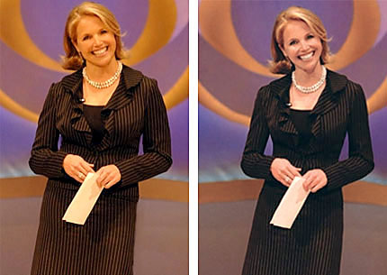
photoshop
Photo manipulation technologies are being utilized by beauty magazines and other media to make already thin women appear even thinner to fit the ideal body standards. (Bradley University, 2017)
A good example of this is when CBS had manipulated a publicity photo of Katie Couric to make her in 2006 making her appear younger and thinner.
Unfortunately, women look up to these media personalities and strive to live up to these digitally manipulated images. (Bradley Univesity, 2017)

Slide 7
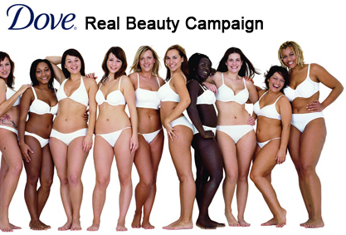
Challenging ideal body standards
In 2004, Dove attempted to challenge ideal body standards inflicted on women by the society through an advertisement to show real beauty.
This was a more realistic representation of American women.

Slide 8
"To all the girls that think you're fat because you're not a size zero. You're the beautiful one, it's society who's ugly." — Marylin Monroe
The media should have representation of different women of all races, looks and sizes. We cannot all fit certain beauty standards since we are all of different shapes and sizes. (Hawkins, 2017)

Slide 9
Health and nutrition – eating disorders
Ideal beauty standards are one of the major reasons women are obsessed with weight loss and eating disorders such as Anorexia Nervosa and Bulimia Nervosa.
There are however normal body- image concerns for example when one is focused on engaging in a healthy eating plan or exercise program while maintaining a reasonable level of self acceptance.
However, if one’s self worth is based entirely on their looks then it becomes an obsession to lose weight instead of maintaining health and overall wellness. (Bradley University, 2017)

Slide 10
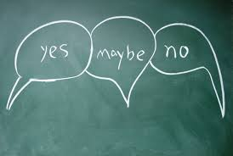
Cosmetic surgery - controversies
While we blame societal standards, media and technology for undue pressure on women to attain certain beauty standards, it is still a controversy whether this is really a feminist issue.
Most women who undergo plastic surgery describe their experiences as empowering. While most admit that a big part of their inspiration was draw from social media, they do not admit that insecurity about their looks is also a factor. (Hale,2017)
There are feminists who wish to undergo plastic surgery. The main argument is that feminism is about having a choice and this includes the choice to look how one feels best;

Slide 11
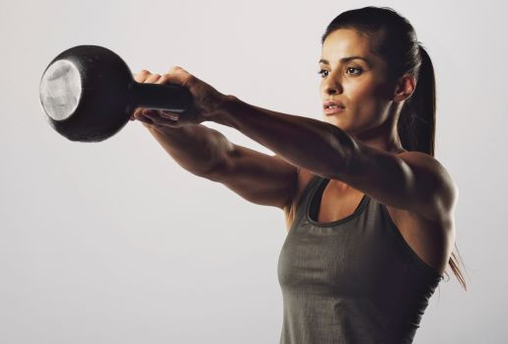
Fitness and feminism
Another interesting area where equality of men and women has been an issue is the gym.
The fitness culture today has changed with women being allowed to do the same exercises as men in the gym.
Traditionally, women were not allowed to lift heavy weights. Exercise was limited and only for the purpose of fat burning aerobics and toning abs and butts.
Strength training increases physical confidence and there are women who appreciate strength training exercises.

Slide 12
we are the change we want
Women have the most power to break societal idealism of beauty.
It begins with self acceptance and confidence in our inner and outer beauty. Beauty is within each and everyone it only takes the right people to appreciate it.
"I don't like standard beauty. There is no beauty without strangeness." — Karl Lagerfeld
Real empowerment is embracing oneself wholly, especially our flaws since they make us unique

Slide 13
Role of the media
The media has a huge role to play in changing beauty standards to a more realistic level.
All women of different colour, race and sizes should be well represented in advertisements and among the media personalities
A universal message that every woman is beautiful in her own way.
Emphasis on health and fitness for overall well-being

Slide 14
Conclusion
Beauty standards are a social construct and they vary from culture to culture.
Women are unnecessarily subjected to undue pressure to conform to unattainable beauty standards causing them to have low self esteem and to engage in unhealthy weight loss programs, plastic surgery and photoshop. Men are not subjected to such pressure concerning their bodies.
Women should learn to embrace their flaws naturally and find confidence from within.
The media and technology should be fully representative of women from all walks of life and of all sizes.
We have the power to change these societal standards since we have inflicted them on ourselves.

Slide 15
REFERENCES
Bradley Univesity (2017) The Body Project. Retrieved from https://www.bradley.edu/sites/bodyproject/standards/
Hale K. ( May 25, 2017) Is Teenage Plastic Surgery a Feminist Act? Retrieved from http://www.harpersbazaar.com/culture/features/a9555312/teenage-plastic-surgery-feminism/
Hawkins H (Mar 7, 2017) Society's Beauty Standards. Retrieved from https://www.theodysseyonline.com/societys-beauty-standards

